Slide 1

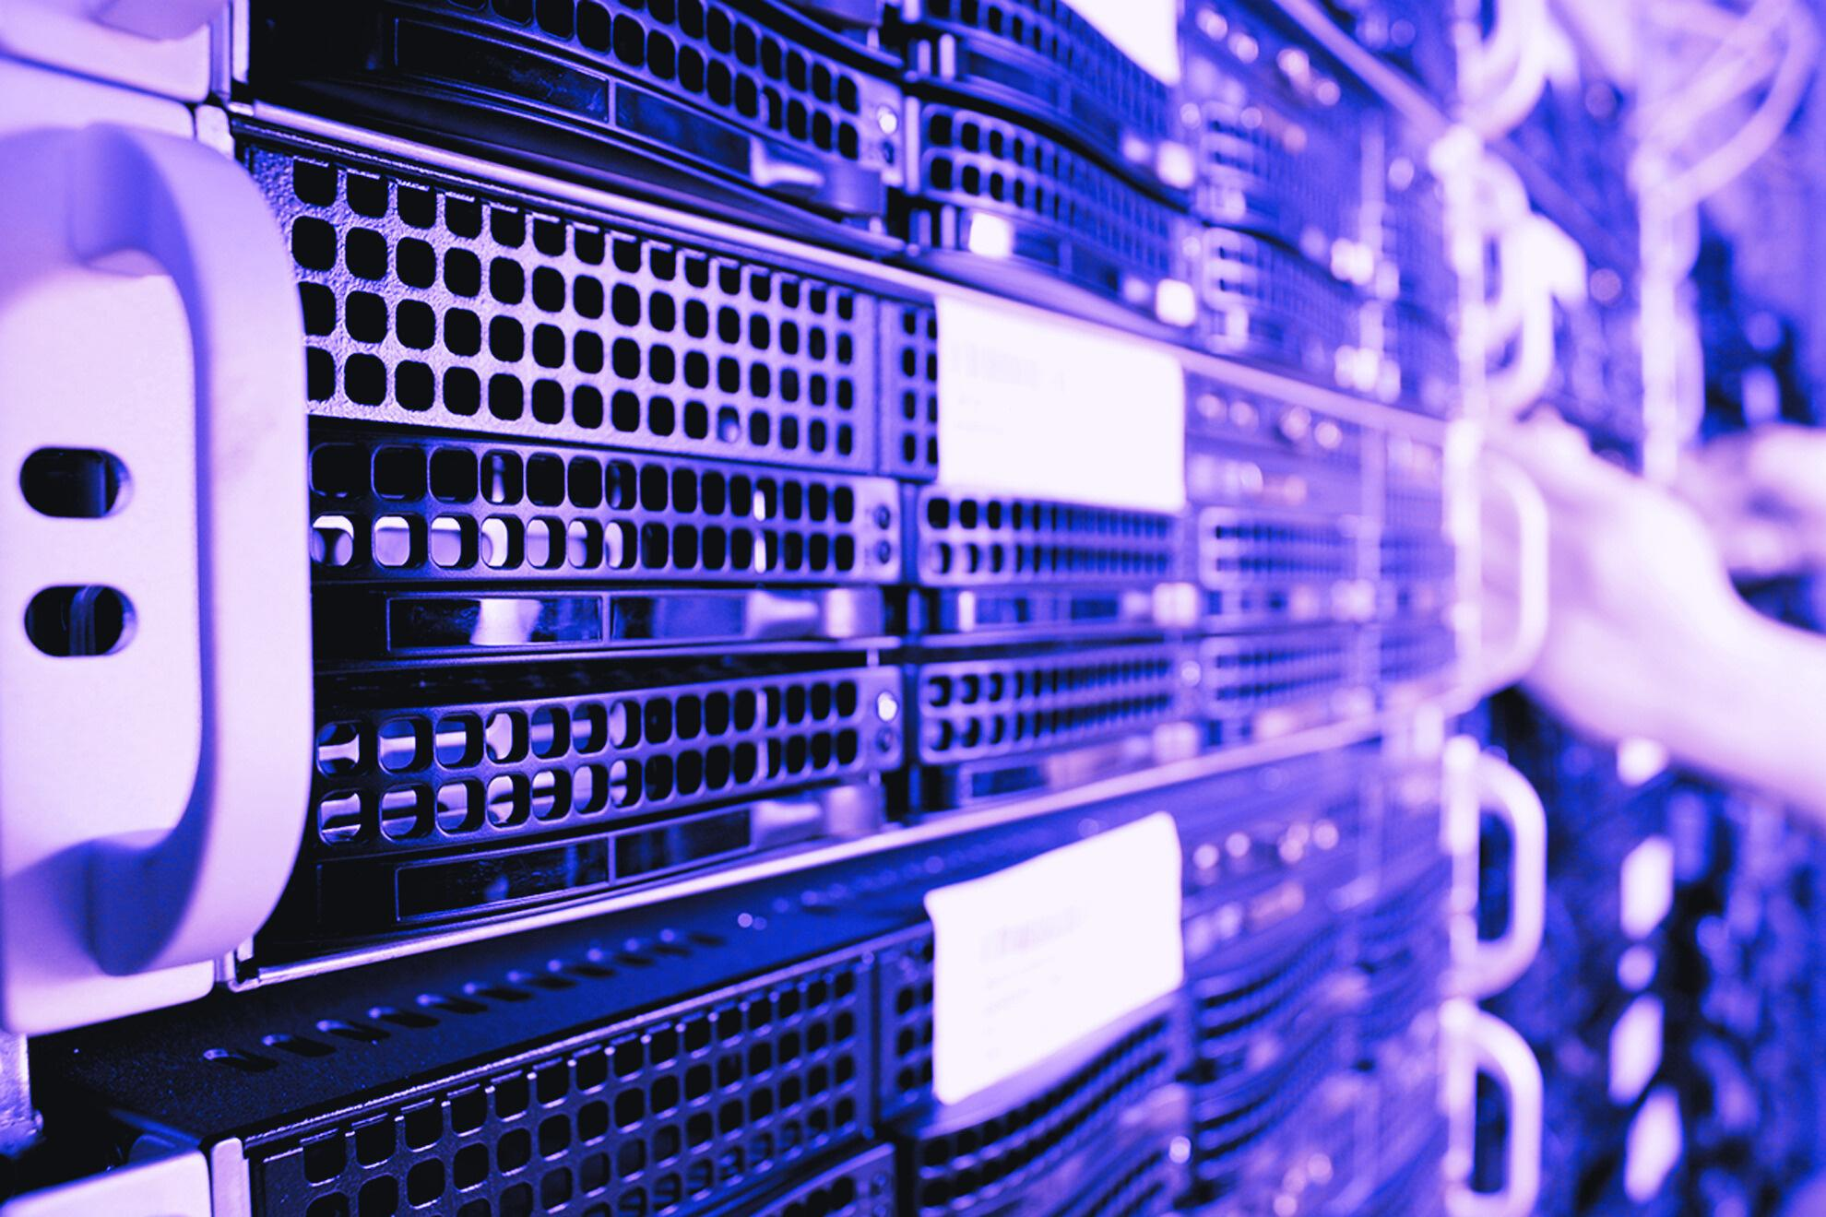
RANSOMWARE
Syed
Kryselle Matienzo
Rashin Zeighami
Suhasini Manchineela
Ampem Darko
12.08.2023
Centennial College
CBER701-Sec002-Group5

Slide 2
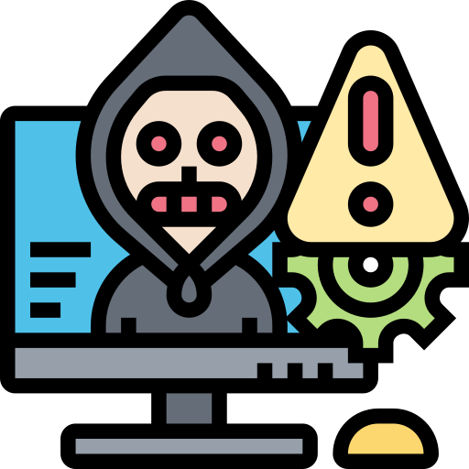

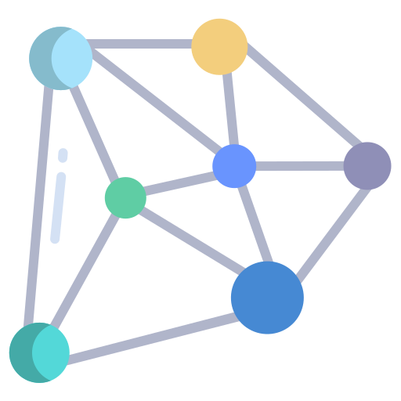
Agenda
What is ransomware?
Types, Evolution & Overview
WannaCry/WannaCrypt
Other famous ransomware
Future research directions
Conclusion

Slide 3


01
What is ransomware?

Slide 4
Common Types
Locker Ransomware
Scareware
Locks victims out of their devices, displaying a ransom note demanding payment to regain access.
Involves coercing users into downloading software by bombarding them with pop-ups and alarming messages, creating a false sense of urgency.
Crypto Ransomware
Encrypts important files, holding them hostage until a ransom is paid for the decryption key. Attackers often provide countdowns and warnings about potential data deletion.
Leakware (Exfiltration/Doxware)
Threatens to release sensitive data online, aiming to extort money by exploiting individuals or businesses' desire to protect confidential information.
Ransomware-As-A-Service
Operates as a dark web business model, streamlining ransomware attacks by automating various aspects, including deployment, payment collection, and user access restoration.

Slide 5

Evolution on Ransomware
Generation I:
Before 2013
Generation II:
2013
Generation III.a (Trojans)
2016
Generation III.b (Worms)
2017

Slide 6
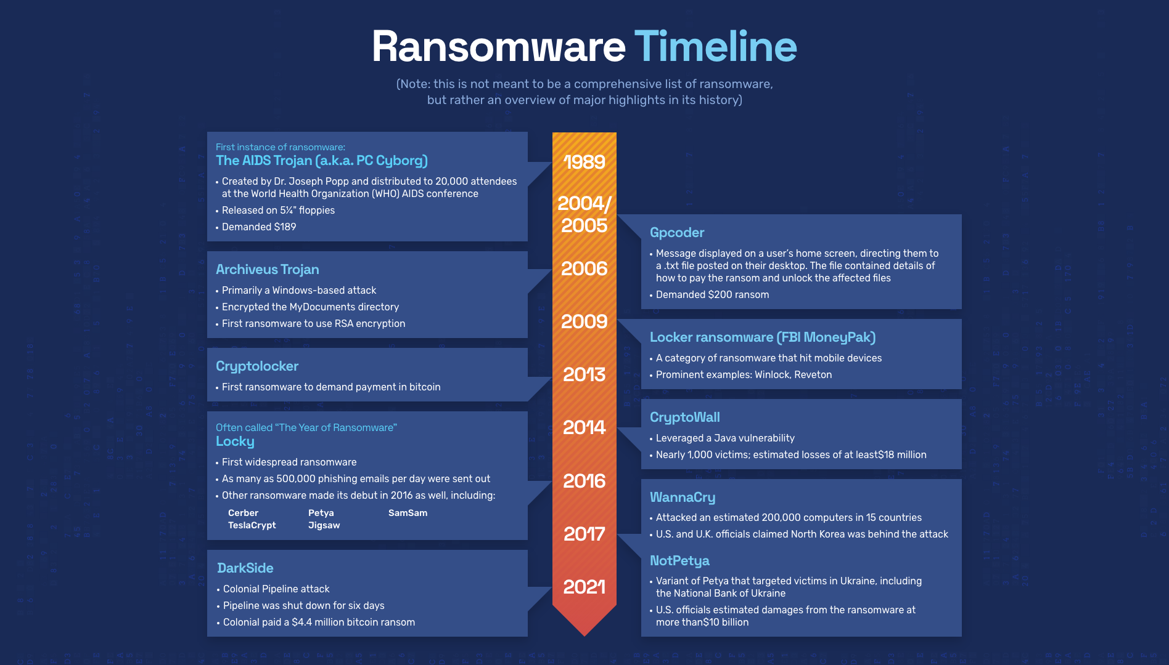

Slide 7
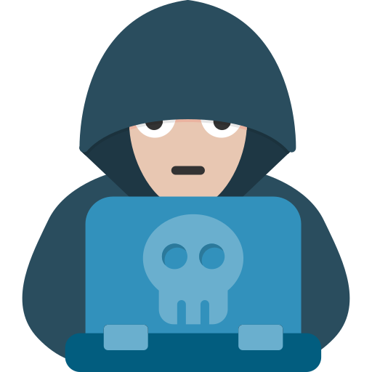
Common ways Ransomware spreads
Remote Desktop Protocol (RDP)
Exploiting RDP Vulnerabilities
Email Attachments
Removable Devices
Deceptive attachments
Infected USB
Malicious URLs
Pirated Software
Fake websites
Illegitimate software

Slide 8
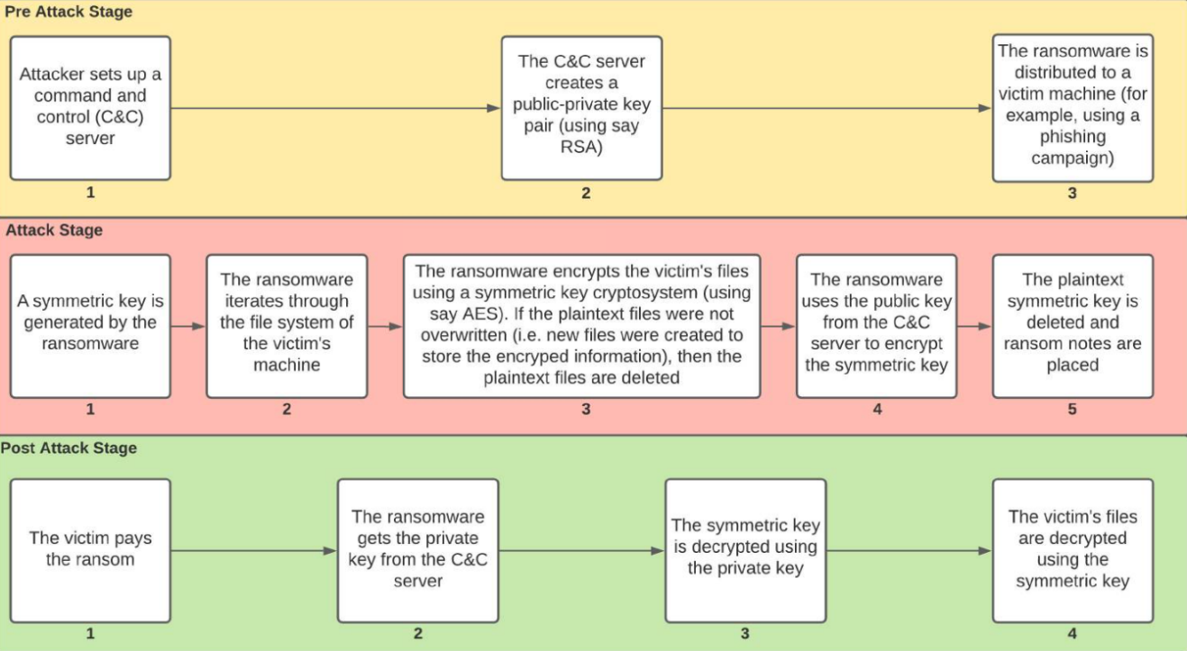
Hybrid Approach of Ransomware

Slide 9
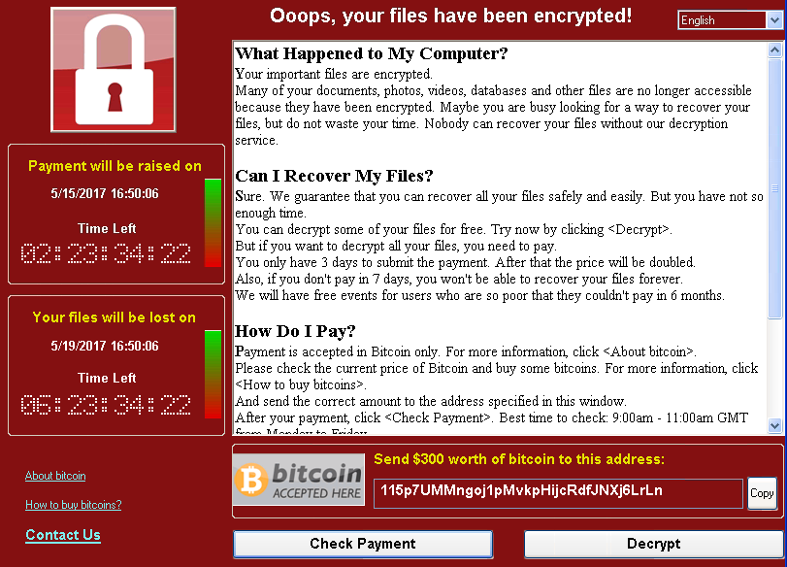
WannaCry/WannaCrypt
Ransomware (vulnerability in SMB protocol)
Believed to be the Lazarus Group
Multiple (global attack); Microsoft Windows users
Estimated $4 billion
nearly 5 million devices by May 2019
EternalBlue exploit

Slide 10
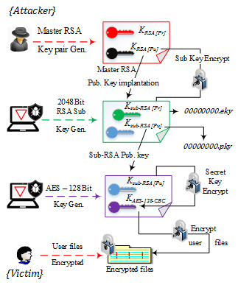
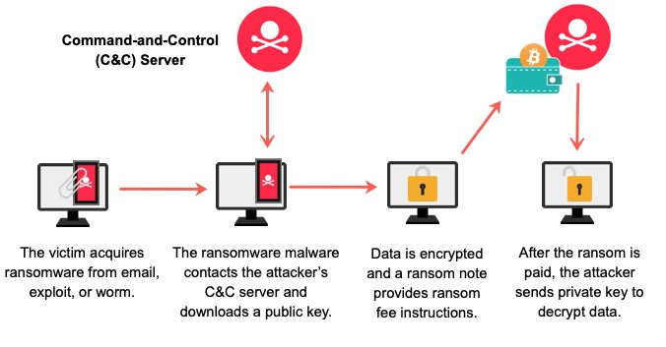
How does WannaCry works?

Slide 11
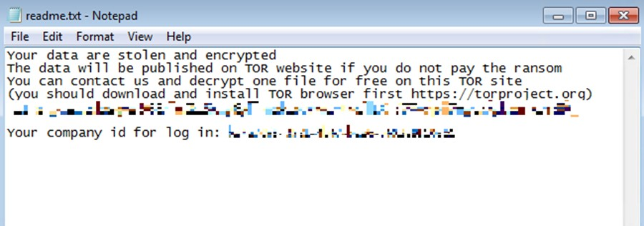
Other famous ransomware
June 2017 Expetr/ NotPetya
Oct 2023 Toronto Public Library
Ransomware (A wiper exploiting an SMB vulnerability)
Likely Russian-sponsored threat actors
Various, but severely impacted Maersk and Merck
Estimated $10 billion
Black Basta Group, operating since Apr 2022
Double extortion tactic
Encrypting data
Threatening to publish it

Slide 12
Impact of Ransomware on Businesses
Extended Downtime
Damage to Brand Reputation
Financial Impact of Ransom Payments
Sensitive Data Exposure
Ransomware as a Gateway to Future Attacks

Slide 13

Future Research Directions
Deepfake Ransomware
Blockchain-based Countermeasures
Remote Working Vulnerabilities

Slide 14

Conclusion
Types, evolution, and encryption mechanisms
Business impact: financial, reputational, and operational
Serves as a stark reminder of the need for robust cybersecurity practices
Preventive, detective and response strategies

Slide 15
Thank you!

